Slide 1
Money Opportunity Application
Midterm Project Report
April 5, 2022
Nathaniel Rowe(nar2@hood.edu)
Veronica Stewart(vss1@hood.edu)
Gaganpreet Kaur (gk7@hood.edu)

Slide 2
What is the Money Opportunity Application? What is our goal? Project Plan?
The Money Opportunity Web Application: Provides and suggests users on how to save money, and have enough money for retirement.
Goal: To display the current financial summary, how much the user wants to save, and interests in jobs depending on what they want.
Plan: Save user’s input and giving tips and suggestions on how to make more money. Also saves money from user’s input of current salary, annual deposit, and interest rate for a certain amount of years.
Notes:
Fix goal for and remove highlight after fixing it

Slide 3
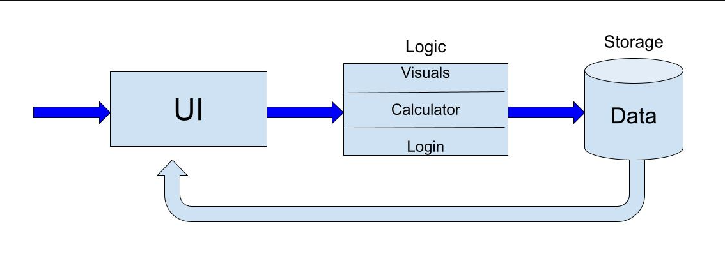
Map Diagram
API

Slide 4
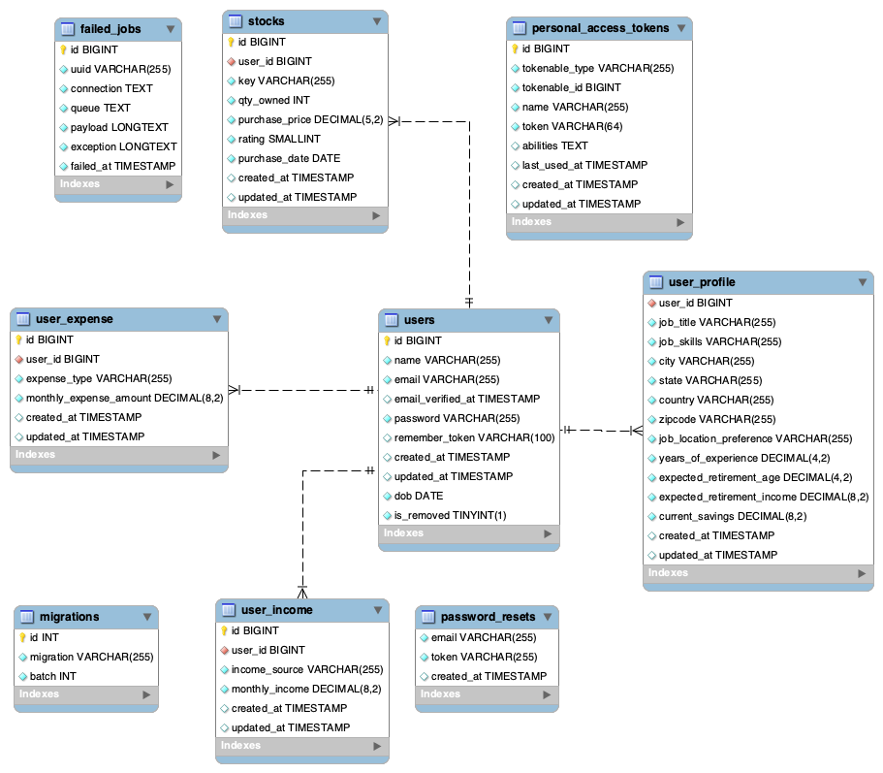
ER Diagram
Notes:
There may need to be some changes for the ER Diagram

Slide 5
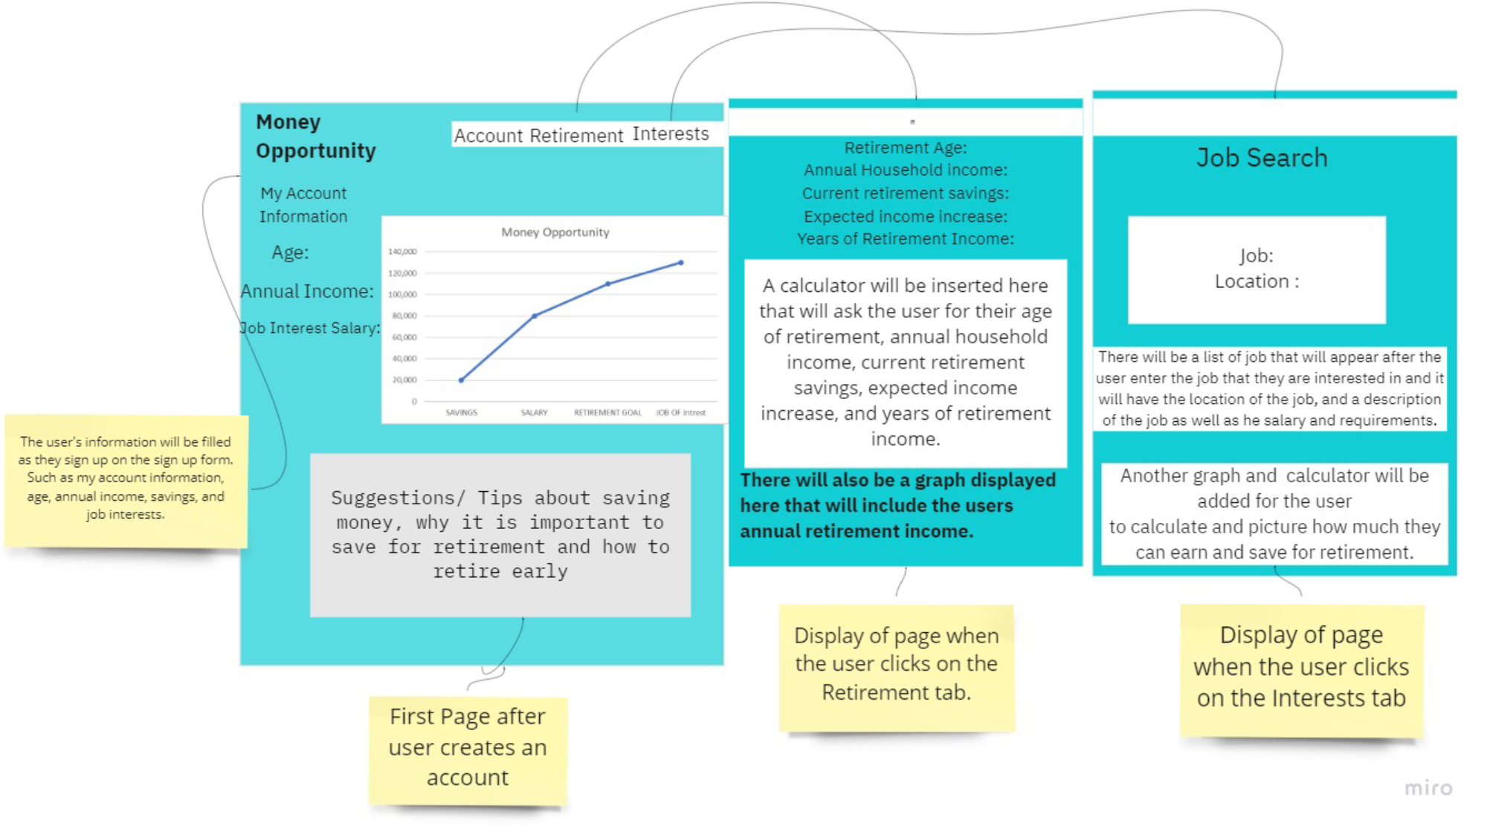
Wire Frame

Slide 6
Tech Stack of our Money Opportunity Web Application
PHP -Backend Development
HTML - Backend development
MYSQL - Data Storage
Laravel - Framework
Bootstrap - front-end development
Docker - Platform
Linux - Software
Notes:
Describe what each language was used for. When speaking

Slide 7
Accomplished Work
Login and User Registration workflow
System captures Income and Expenses from multiple sources
System displays monthly and yearly income, expenses, and savings.
Lines of Code: 10K+
Classes: 20+
Database Tables: 8
Notes:
This is slide is explaining what has been done within the project with bullet points with the 3 key features

Slide 8
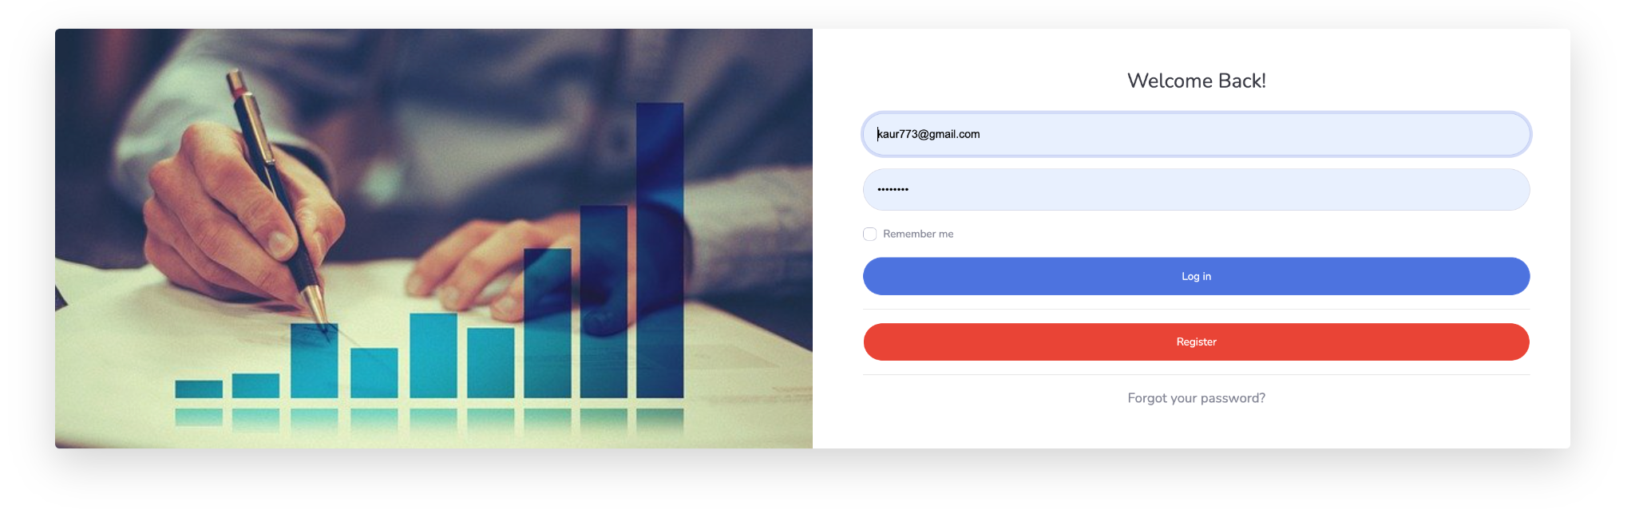
Screenshot of Accomplished Work
Notes:
Videos and or screen of the different pages within the webpage

Slide 9
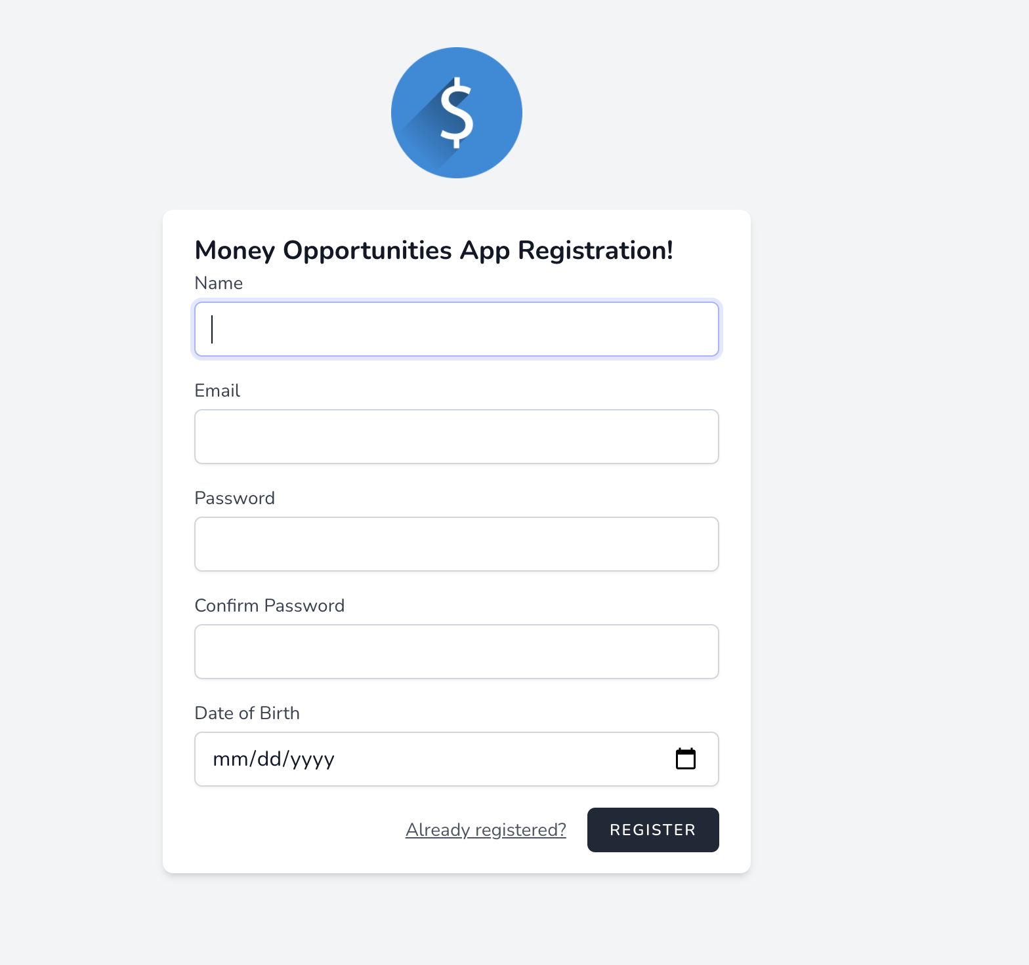
Continue

Slide 10
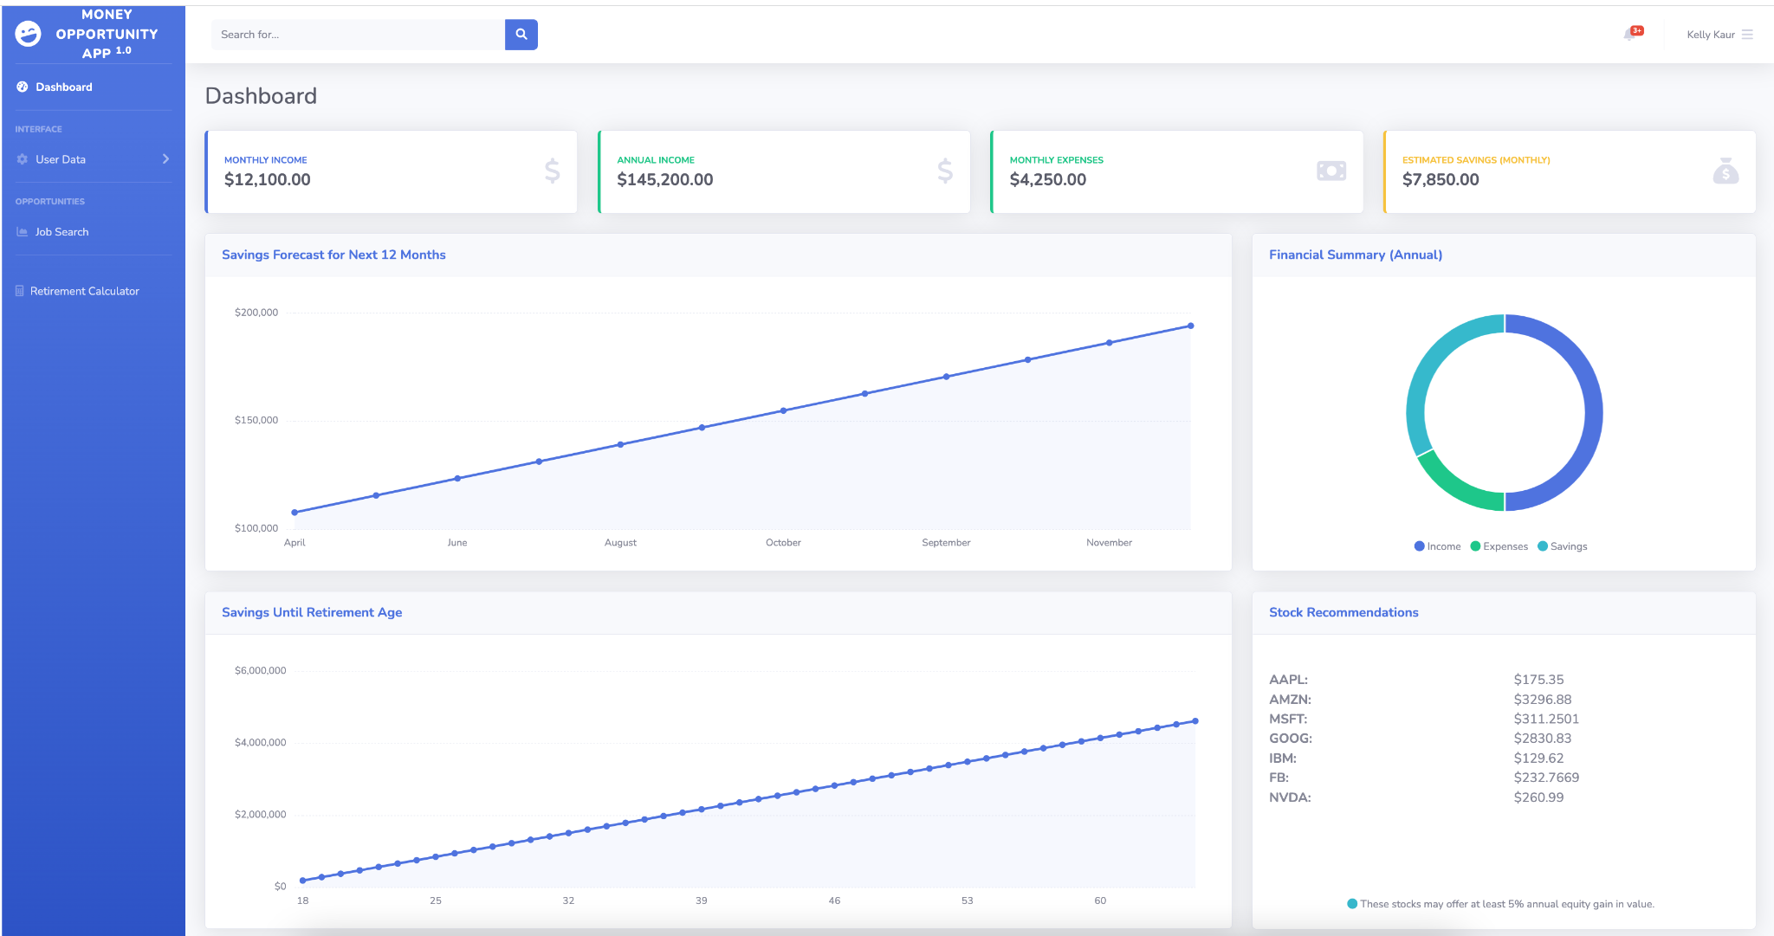
Continue

Slide 11
Effort: Operations
How did we communicate as a team? Attended zoom meetings, phone calls, text messages, and in person meetings
How did we operate as a team? Meetings, Communication, Task assignment
Development methodology- Agile methodology. Agile breaks up the work into smaller tasks and allows for a finished product more efficiently.
Agile Methodology
Pros | Cons
Flexibility | Difficult Measurement
Continuous Development | Time

Slide 12
Effort: Roles
Team Members | Roles | Hours Spent
Gaganpreet Kaur | Full stack development to create user interfaces for Login, Registration, Homepage, Database setup, Stock API Integration, Modal, Controller, and View classes. | 50
Nathaniel Rowe | Retirement Calculator | 24
Veronica Stewart | Database connection, API connection, User Interface | 34

Slide 13
Lessons Learned & Challenges
Challenges:
Connecting to Docker on Windows
Creating the Retirement Calculator
Connecting to a Job search engine API
Using a New Frame (Laravel)
Connecting to database
Lessons Learned:
Communication is Key- problems with agreeing with software framework
Research is important
Notes:
Had a disagreement with the framework that we wanted to use

Slide 14
Expected forthcoming activities
What is left to do? | How will we accomplish it?
Finishing retirement calculator (adding recursive code) | Make correct edits to make the retirement calculator more efficient.
Job Search API connection | Connecting to an API
Need User Interface for Job Search, Job Recommendations, Savings Recommendations and Calculator pages | Bootstrap for Job Search template Connect to API from websites about saving suggestions

